Slide 1
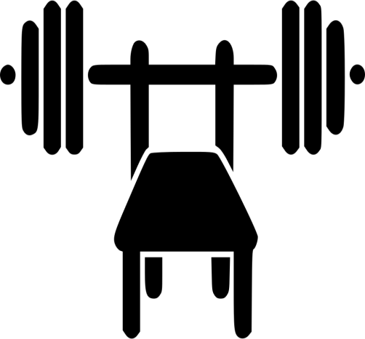
201721508
E-Business
Jeon Kyeongmin
Weight Training
Chest Motion
Routine

Slide 2
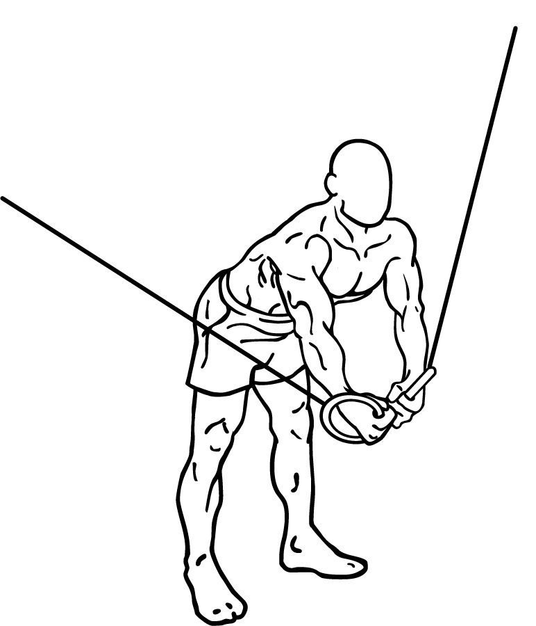
0.Cable Crossover
This warming up allows the blood to circulate throughout. 5 sets (the same weight)

Slide 3
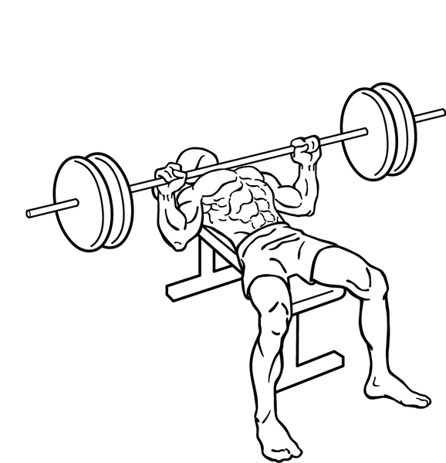
1.Flat Bench Press
8 seconds for relaxation, 4 seconds for contraction.
5 sets (Add 5kg)

Slide 4
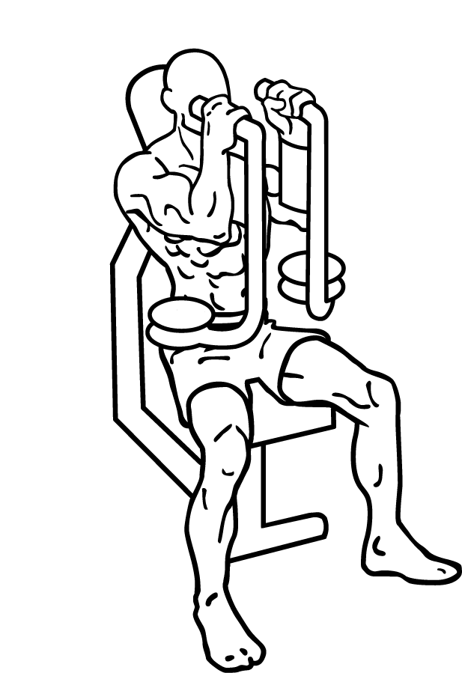
2.Fly Machine
Proceed immediately without stopping after 1. To give sustained chest fatigue.
5 sets (the same weight)

Slide 5
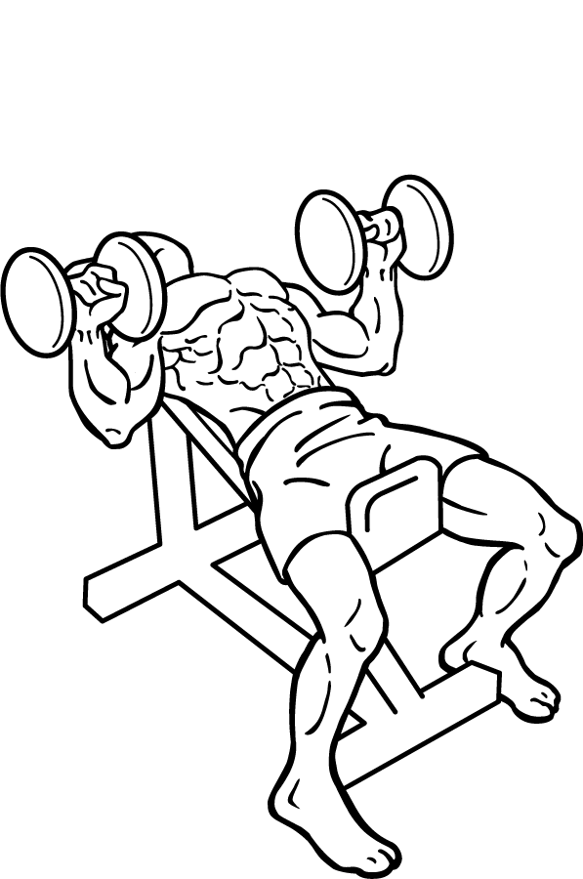
3.Incline Dumbbell Press
Develop upper chest movement.
Detail stimulation and increased muscle mass
5 sets (Add 2kg)

Slide 6
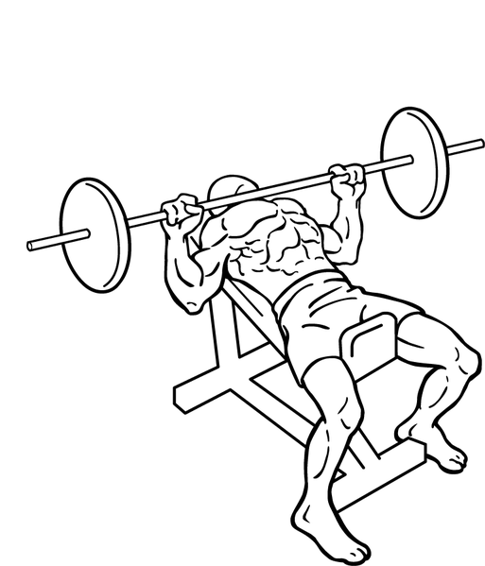
4.Incline Bench Press
Think I lifted it to the side when lifting the barbell.
Maximum relaxation.
5 sets ( the same weight)

Slide 7
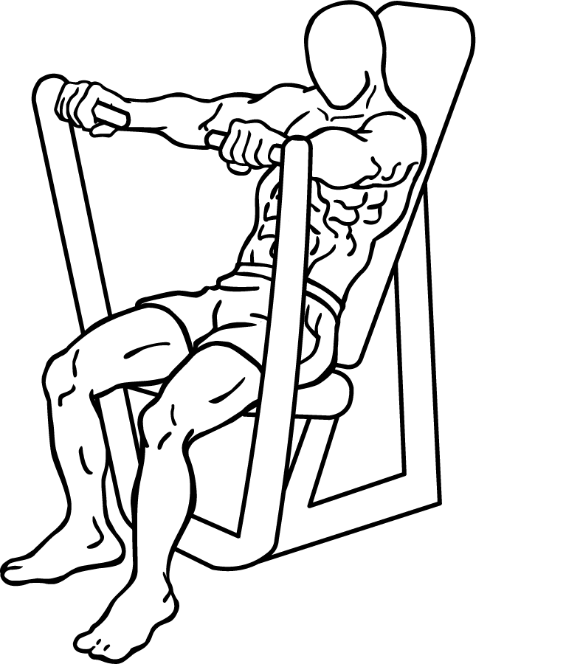
5.Chest Press Machine
Proceed to complete the remaining power in the chest. Turns blood out of flat.
5 sets (the same weight)

Slide 8
6.Cable Crossover
The target muscle at the outer and lower sides of the chest. Proceed to the limit without setting the number of sets.

Slide 9
THANK YOU

